Slide 1
Workplan & Progress overview

Slide 2
Workplan
Dates correspond to the end of a chunk
Chunks 1-4 (Jan 31)
Tutorials and planning √
Chunk 5 (Feb 14)
Write GS function in ML √
Chunk 6 (Feb 28)
Check termination √
Chunks 7-8 (Mar 28)
Prove output is bijection/permutation √
Chunks 9-10 (Apr 25)
Prove output is stable
Chunks 11-12 (May 23)
Write the report
May 28 submission deadline

Slide 3
Current progress Mar 16
Prove output is bijection (by: Mar 28) √
3 subparts: output is:
Distinct (no 2 men are married to the same woman at any time) √
Complete (all men are married) √
This is the bulky part
Bounded (all women the men are married to are well-defined indices, i.e. w < N) √

Slide 4
lemmas Proven so far
Detailed look…

Slide 5
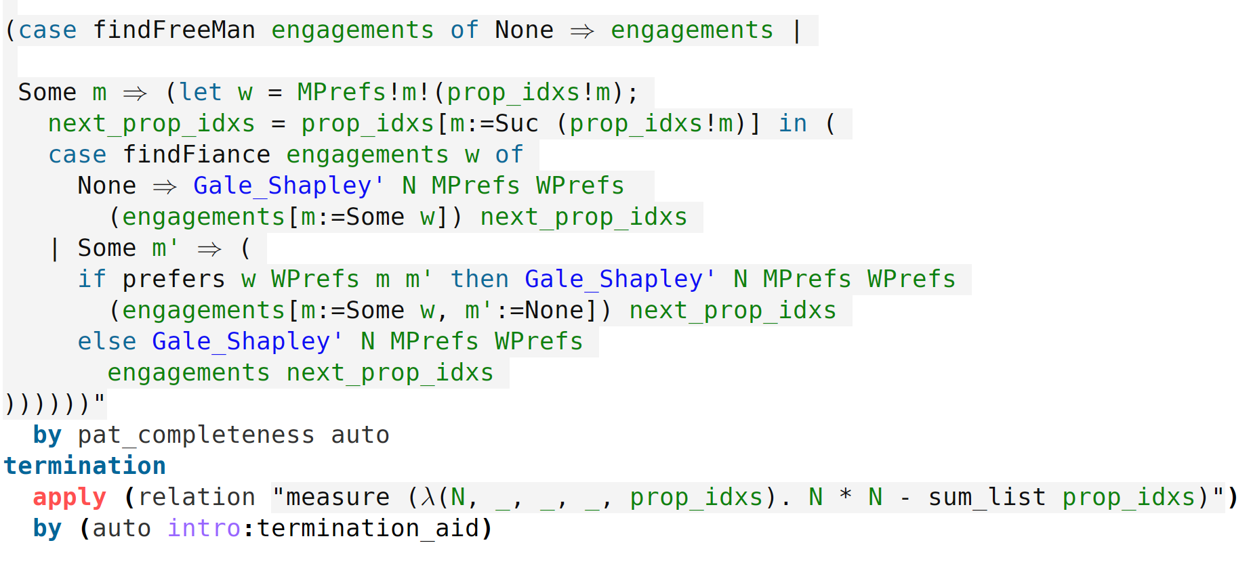
Termination

Slide 6
GS’_arg_seq
Gale_Shapley' N MPrefs WPrefs engagements prop_idxs
A tail-recursive function that outputs its 4th argument (engagements) when certain conditions concerning (N engagements prop_idxs) are satisfied
N MPrefs WPrefs are fixed
engagements prop_idxs record the computation progress

Slide 7
GS’_arg_seq
Gale_Shapley N MPrefs WPrefs
= Gale_Shapley’ N MPrefs WPrefs (replicate N None) (replicate N 0)
Initial state
engagements: Everyone is unmarried
prop_idxs: all men haven’t proposed to anyone

Slide 8
Natural auxiliary function to help express lemmas
GS’_arg_seq N MPrefs WPrefs engagements prop_idxs
Computation same as Gale_Shapley’
But instead of being tail-recursive
Appends each step’s (engagements, prop_idxs) to a list
GS’_arg_seq = [(replicate N None, replicate N 0), …, …, …, (output, some_prop_idxs)]

Slide 9
GS’_arg_seq
theorem GS'_arg_seq_computes_GS':
"Gale_Shapley' N MPrefs WPrefs engagements prop_idxs
=
fst (last (GS'_arg_seq N MPrefs WPrefs engagements prop_idxs))"

Slide 10
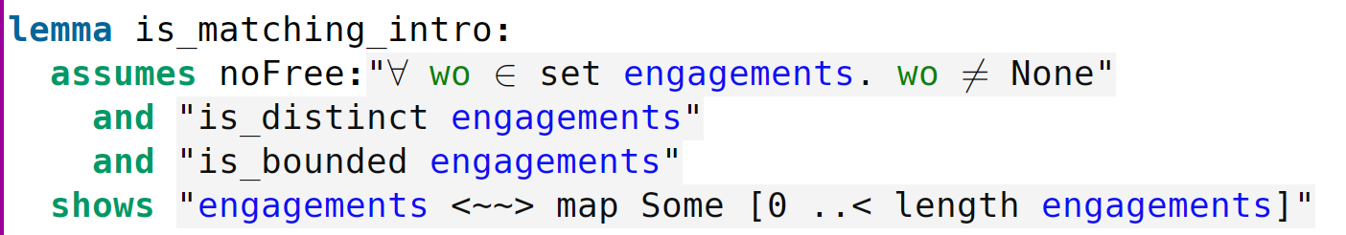
3 subparts of bijection

Slide 11
is_distinct
lemma GS'_arg_seq_all_distinct:
"⟦
is_distinct engagements;
(X, Y) ∈ set (GS'_arg_seq N MPrefs WPrefs engagements prop_idxs)
⟧ ⟹ is_distinct X"

Slide 12
Key lemmas leading up to complete (noFree)…
married_better w WPrefs eng_1 eng_2
Compares w’s situation in the two engagement states
True iff w is better off in the latter
Crucially have: "⟦
w married in eng_1;
married_better w WPrefs eng_1 eng_2
⟧ ⟹ w married in eng_2"

Slide 13
All women marry better
lemma GS'_arg_seq_all_w_marry_better:
"⟦
seq = GS'_arg_seq N MPrefs WPrefs engagements prop_idxs;
is_distinct engagements;
i < length seq; j < length seq;
i < j
⟧ ⟹ married_better w WPrefs (fst(seq!i)) (fst(seq!j))"

Slide 14
When any man is done proposing we’re just done
GS'_arg_seq_any_man_done_proposing_means_done:
"⟦
seq = GS'_arg_seq N MPrefs WPrefs (replicate N None) (replicate N 0);
is_valid_pref_matrix N MPrefs;
(engagements, prop_idxs) ∈ set seq;
m < N; prop_idxs!m = N
⟧ ⟹ None ∉ set engagements"

Slide 15
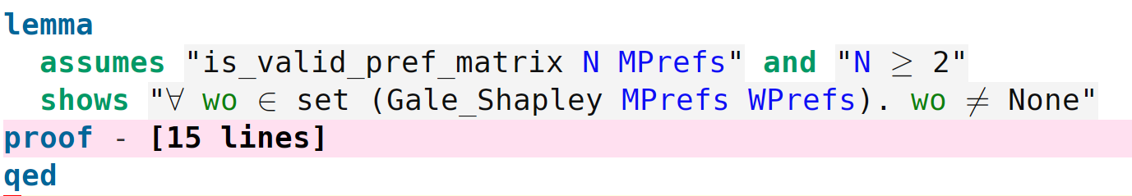
Complete (noFree)

Slide 16
is_bounded
lemma GS'_arg_seq_all_bounded:
"⟦
seq = GS'_arg_seq N MPrefs WPrefs (replicate N None) (replicate N 0);
is_valid_pref_matrix N MPrefs;
i < length seq
⟧ ⟹ is_bounded (fst(seq!i))"

Slide 17
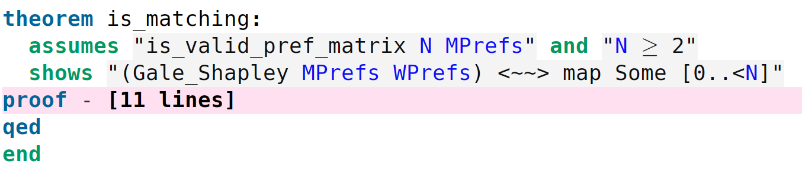
And the Mar 28 milestone

Slide 18
Ending comments

Slide 19
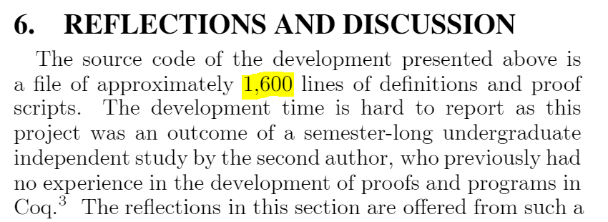
Gale_Shapley.thy: 1583 lines and still going!

Slide 20
Most progress demonstrated so far is completely original
Especially all the work leading up to complete (noFree)
The bulky part!
Everything else (where some can possibly be argued as unoriginal) is trivial…

